Slide 1
Oskari for Admins and Purchasers

Slide 2
Oskari administrative functions
Managing map layers
User management
User roles and rights on different roles
Default view
Monitor the availability of map layers
Administering embedded maps
Announcements

Slide 3
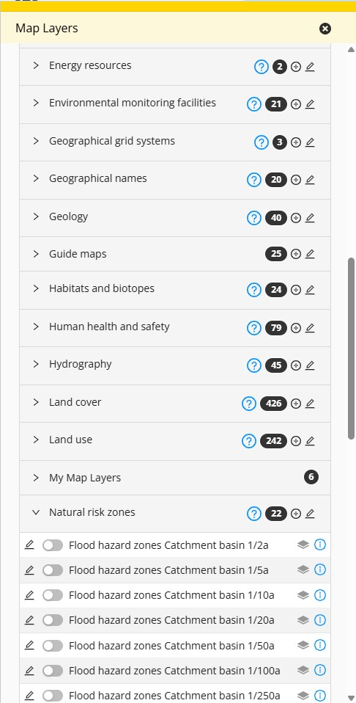
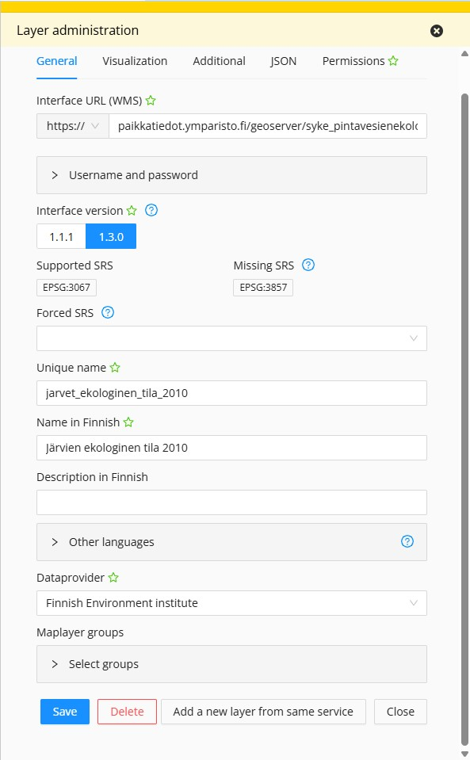


Maintenance of map layers
Alternatives:
Import the layers via an API (admin)
Import the layers from files (a logged in user)
Create own features (a logged in user)
The maintenance of map layers:
Add or edit the information of map layers (see right)
Visualisation
Filtering of attribute table
JSON
Rights
User rights
view / publish
roles / user account

Slide 4
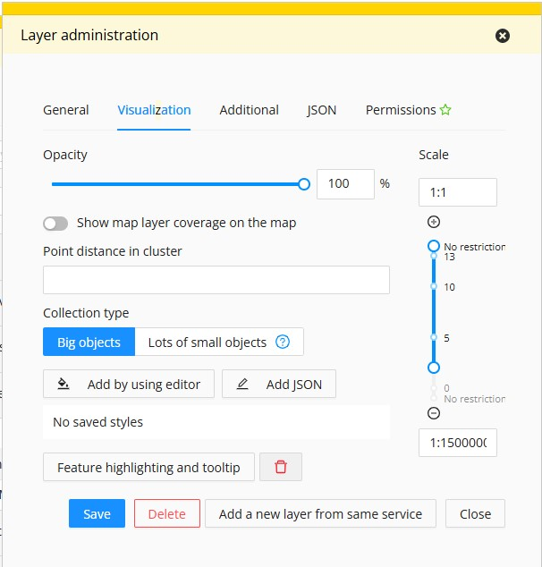
Visualization
The maintenance of map layers:
Add or edit the information of map layers (see right)
Visualisation
Filtering of attribute table
JSON
Rights
User rights
view / publish
roles / user account

Slide 5
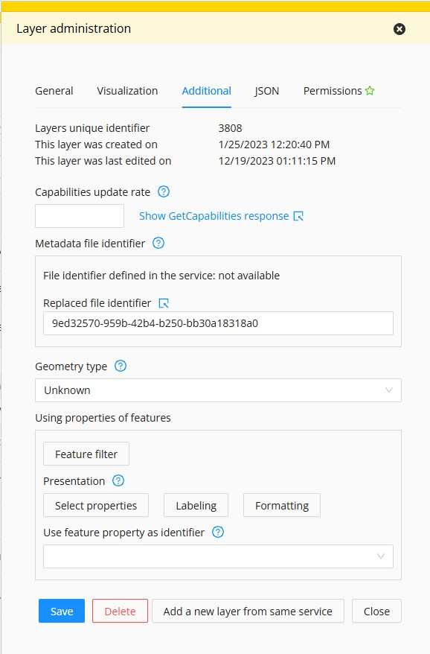
Additional
The maintenance of map layers:
Add or edit the information of map layers (see right)
Visualisation
Filtering of attribute table
JSON
Rights
User rights
view / publish
roles / user account

Slide 6
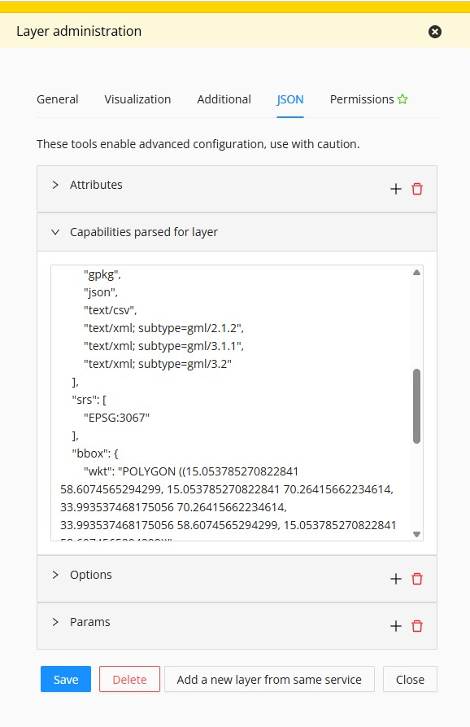
JSON
The maintenance of map layers:
Add or edit the information of map layers (see right)
Visualisation
Filtering of attribute table
JSON
Rights
User rights
view / publish
roles / user account

Slide 7
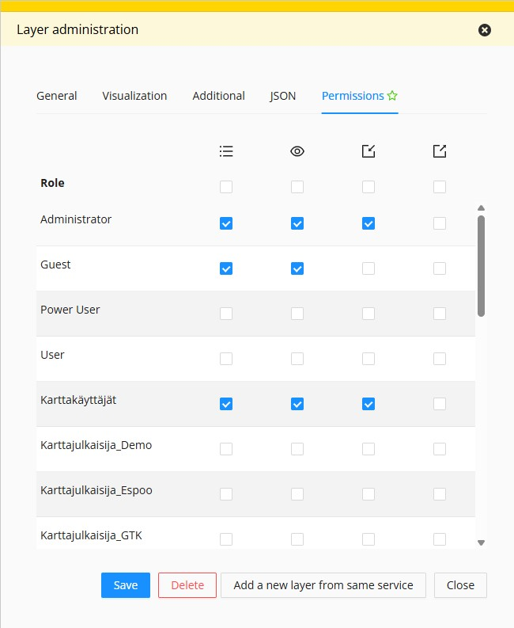
Layer rights
The maintenance of map layers:
Add or edit the information of map layers (see right)
Visualisation
Filtering of attribute table
JSON
Rights
User rights
view / publish
roles / user account

Slide 8
Embedded maps administration
User access limited to published maps
Access restrictions by domain address if needed
Access restricted by user name if needed
Embedded maps may be extended by RPC Application

Slide 9

Data flow in Oskari (simplified)
View only some of the data
View all the data
D
Oskari-based
map service
Geospatial data
Spatial / statistical API
User roles
View and edit

Slide 10
Alternative data flow in Oskari (embedded map)
No access from outside
Choose what to share
Public
Oskari-based
map service
(map embed)
The main
Oskari-based
map service
(intranet)
D
View
Geospatial data
Spatial / statistical API
Admin tools & maintenance in intranet

Slide 11
Purchasing Oskari

Slide 12
Purchasing Oskari
What should one take into account when purchasing Oskari?
Before main points
Main points of purchasing Oskari:
Consider what is the basic need: who and how the Oskari service will be used?
Recognise where you need expertise from elsewhere and what you can do internally
Is the basic Oskari package sufficient as is or does it need to be changed?
Are you buying a new instance or upgrading an old one: the things to consider are different
Plan who will maintain the service once the purchase is made: ensure continuity
Network and learn from others: Oskari users in your own or other organizations, end user

Slide 13
Requirements for Oskari
Necessary:
A server where Oskari is located
Geospatial data that is available via an API
And if needed:
A software (GeoServer, for example) that allows organisation to publish its own data via an API
A database (PostgreSQL + PostGIS extensions, for example) if the organisation wants to allow user the end-users to import their own datasets to the map service

Slide 14
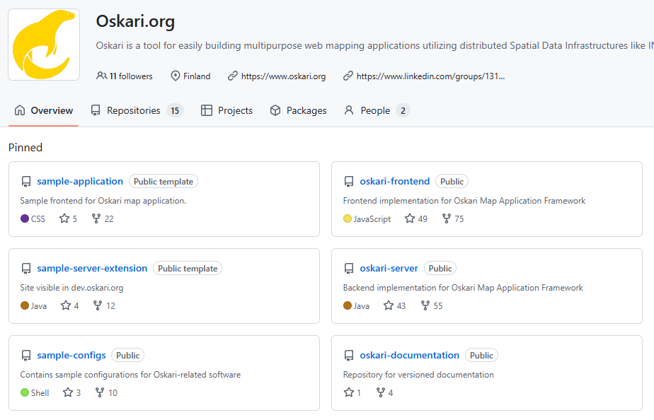
Oskari development and continuity
Oskari is developed together, NLS FI coordinates
Developing follows the open source principles
Anyone can take part in developing
It is possible to do joint development between organizations
The continuity of Oskari is secured by the continuity standards of NLS FI and the whole Oskari Joint Development Forum

Slide 15
The Oskari community
Oskari community is coordinated by National Land Survey of Finland
Product owner, technical coordinator
Communications coordinator as a consultant service
Joint development forum
7 organisations (10/2025): NLS FI, Väylä, DVV, HSY, City of Tampere, City of Joensuu, Ubigu Ltd.
Meetings on a monthly basis: use cases, needs, co-operation possibilities, what’s new
Project steering committee is responsible for the code
Development, consultation, training, support, maintenance
Different companies, no vendor lock-in
Oskari community
Organisations using Oskari: Lounaistieto, Museovirasto, Ruokavirasto…
About 50 people, from both public and private sectors

Slide 16
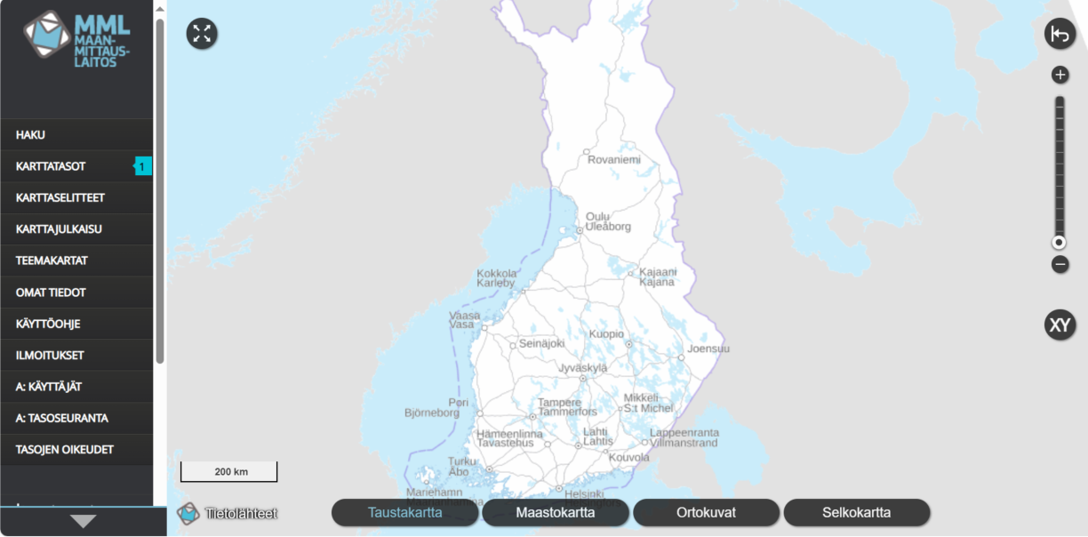
Use case: Suomi.fi maps
A part of Finnish e-services for public sector organisations
Municipalities and other public sector organisations can create and publish embedded maps
Over 1000 map layers
Organisations have roles, which have been granted permissions to different map layers
Organisations ask their own non-public layers to be added to the service
In numbers:
300+ user accounts
approx. 1500 map embeds made
41 mil. map layer views in 2023

Slide 17
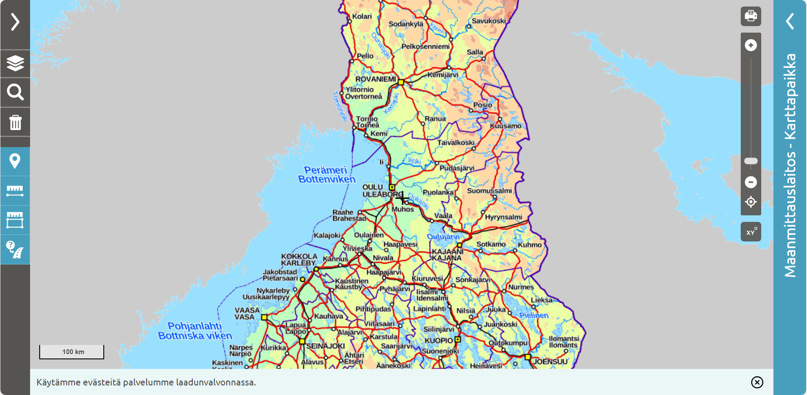
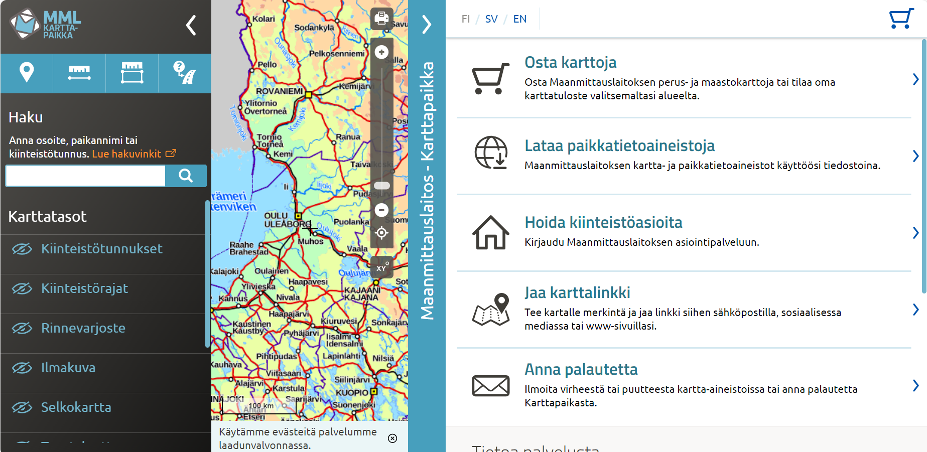
Use case: Karttapaikka (NLS FI)
Made using map embed from Suomi.fi maps karttajulkaisusta and implementing RPC
6 mil. visitors annually

Slide 18
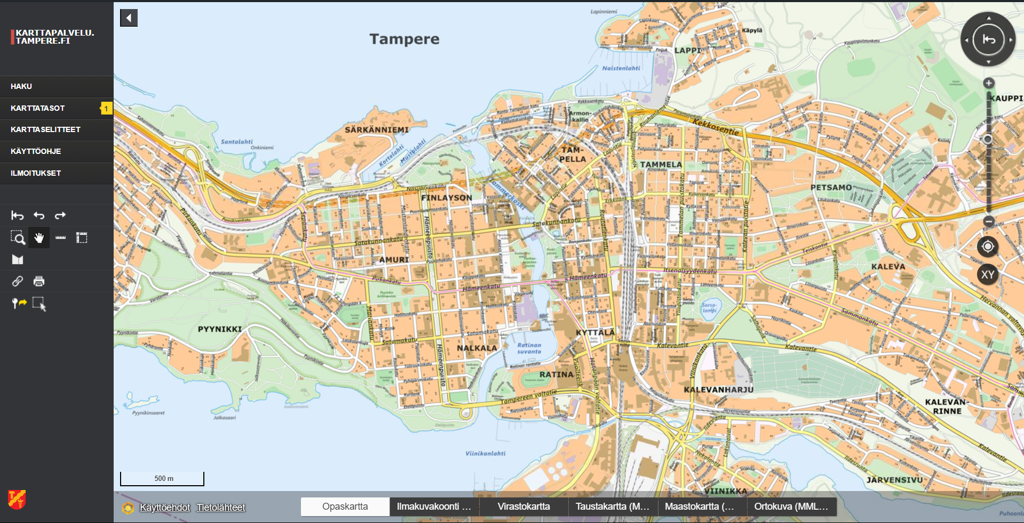
Use case: City of Tampere
The map service for City of Tampere
Configurations include logging in via intranet
An Oskari-based feedback tool has also been made: a split screen view where other half has a survey, the other has map embed that allows adding features to the map

Slide 19

Thank you!
Website: https://oskari.org/
GitHub: https://github.com/oskariorg/
LinkedIn: Oskari - Open Source
Email: info@oskari.org & juho@gispo.fi

